Slide 1
Computer-aided investigation of locus of points in geometry
Jiri Blazek, Pavel Pech

Slide 2
Outline of a talk
Introduction – proofs, CAS, DGS
Simson-Wallace theorem
General approach to solution of a geometrical problem
Problem of searching loci in a plane
Searching for loci in 3D

Slide 3
Introduction - Proving at schools
Proving theorems does not belong to favourite activities in math lessons
On the other hand, without proving there is no mathematics

Slide 4
Introduction - Proving at schools
How to get over this disproportion ?
Make proving more attractive
Persuade students that proofs are necessary
Prove such statements students are doubting about
Show statements which seem to be true but are not valid
Visualize a proof if possible
Show nice proofs

Slide 5
Introduction - Problem searching for loci
Searching for loci of points belongs to the most diﬃcult parts of geometry curricula at all school levels
New technology tools facilitate this problem considerably
Both DGS and CAS can be applied
The valuable topic for students

Slide 6
Introduction - DGS
Programs DGS:
Cannot prove theorems
Helps to formulate and verify conjectures
Important tools (GeoGebra): Relation, Locus, LocusEquation
"A picture is worth a thousand words"

Slide 7
Introduction – DGS Verification
A statement is numerically checked by DGS in many instances
Veriﬁcation in DGS can be considered as the ﬁrst step of proving
Veriﬁcation in DGS can replace a proof in lower classes at schools
Veriﬁcation in DGS is not a proof

Slide 8
Introduction – DGS Verification
There is a high probability that a statement which is veriﬁed in DGS is valid.
Veriﬁcation in DGS motivates students.

Slide 9
Introduction - CAS
Programs CAS:
enable automatic derivation, discovering and proving
work only with equations, it is a matter of a student to interpret these equations in geometrical way
Example: it´s easier to find that two lines are parallel in DGS. But it is harder to see it in equations of CAS.

Slide 10
Introduction - CAS
based on results of commutative algebra in last 40 years.
two basic methods — Groebner bases method and Wu–Ritt method.
(radical) ideal membership theorem, Buchberger’s algorithm.

Slide 11
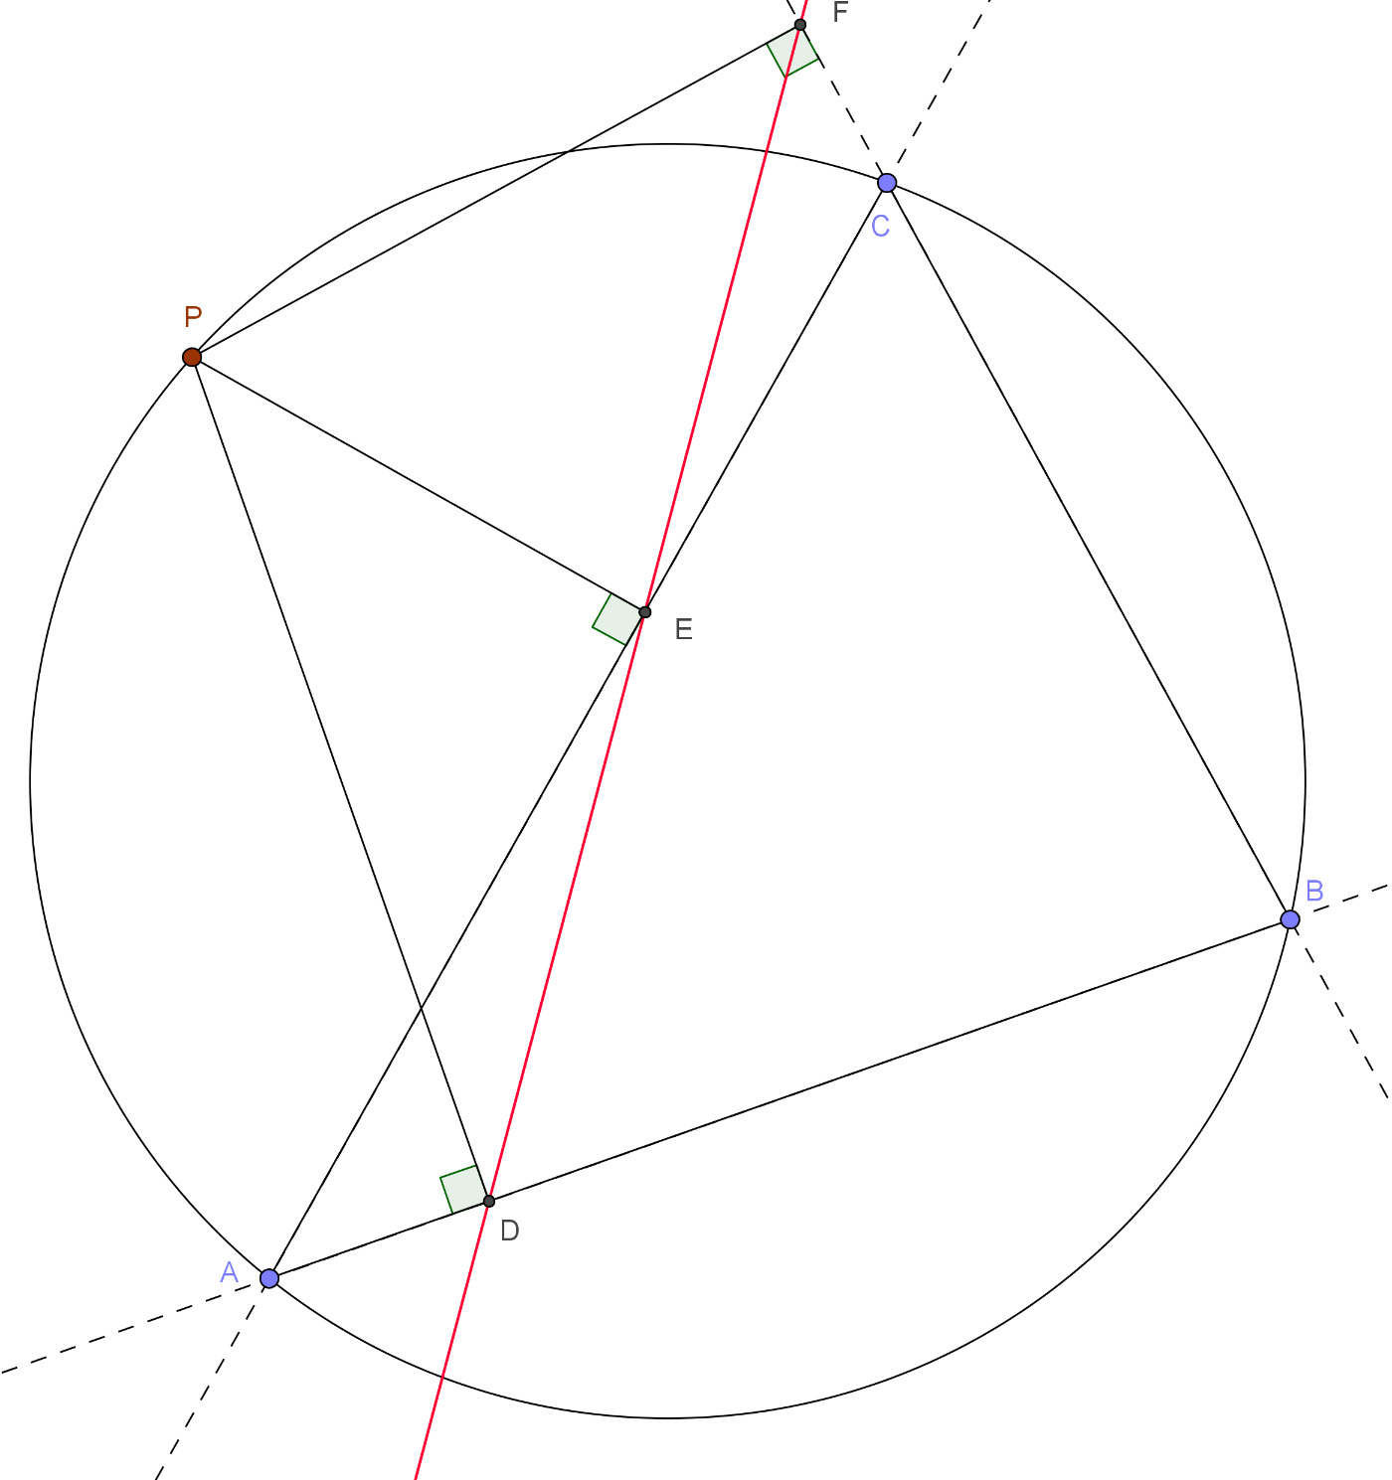
Wallace – Simson theorem
Determine the locus of points P such that, feet of perpendiculars to the sides of a tringle lie in a line.

Slide 12
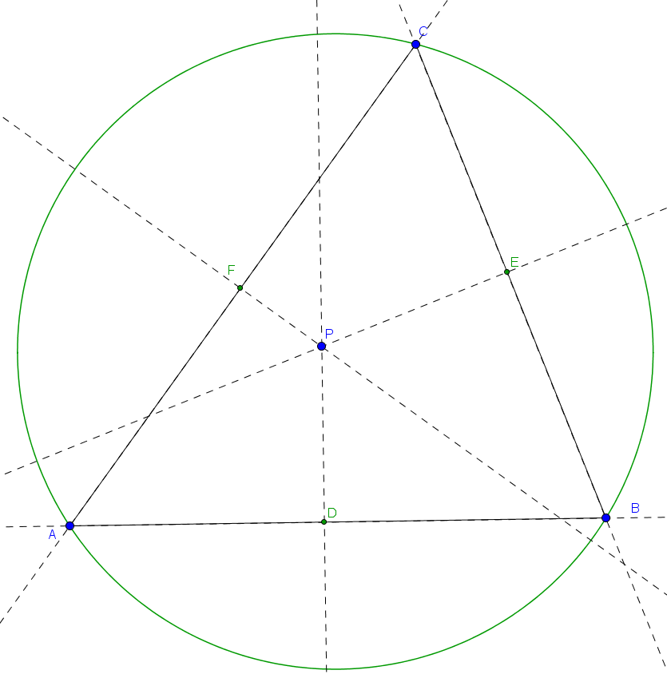
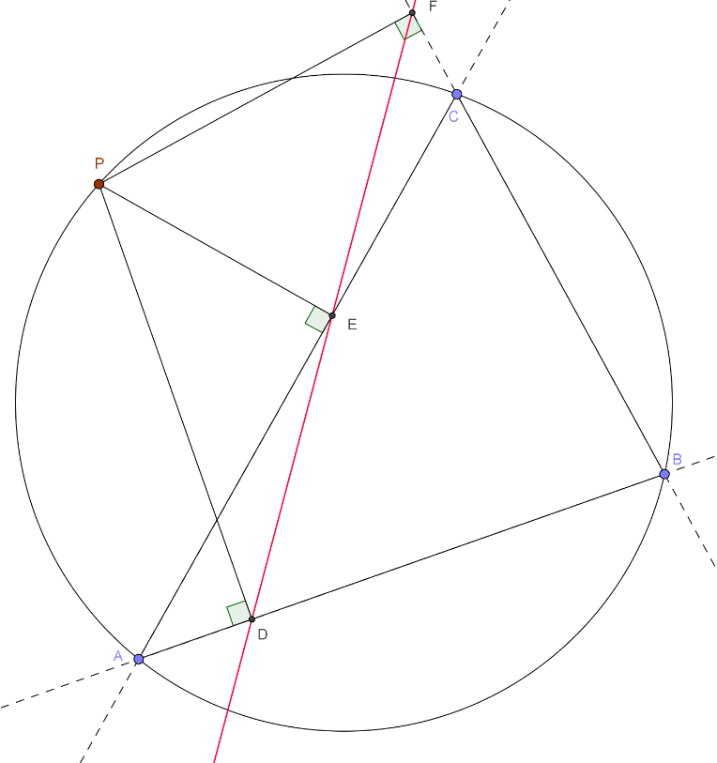
Wallace – Simson theorem: verification and discovering in GeoGebra
„Relation“ (between objects)
Zoltán Kovács – GeoGebra tube
„LocusEquation“

Slide 13
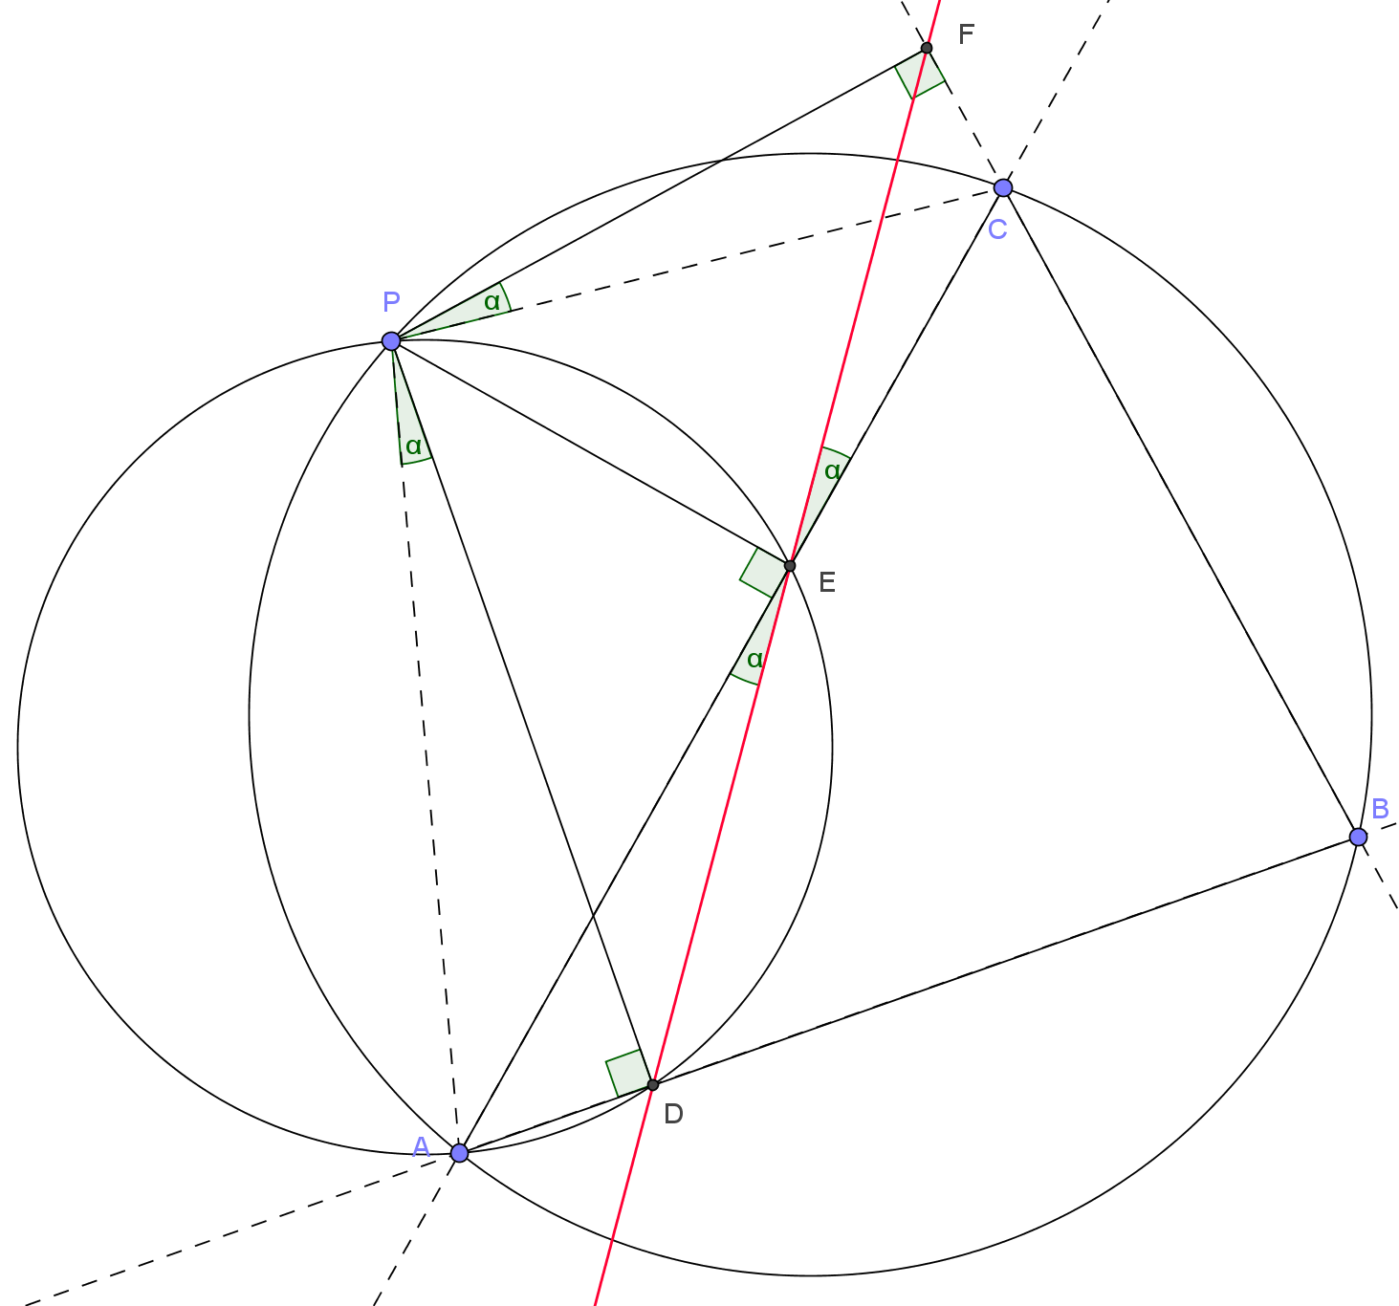
Wallace – Simson theorem proofs
Proof by vertical angles

Slide 14
Wallace – Simson theorem:
Solution by GeoGebra
Advantages:
exact
fast (saving time)
support for finding classical solution
Disadvantages (from the view of teacher):
a black box
We don’t know: why?
It is not general solution
The most valuable is a classical solution. But we cannot relay, that it will be found in every case.
We need a key idea.

Slide 15
Searching for loci - General Approach I
Try to solve problem by a classical way
The best solution is a classical one as it provides insight to the problem
But the success depends on a key idea.
If there is no key idea, there is no solution

Slide 16
Searching for loci - General Approach II
Did you fail? Try DGS.
We can test the problem to get a conjecture
It is much easier to see new relations between objects in DGS than in a hand made sketch
It is much easier to find solution if we know what we look for

Slide 17
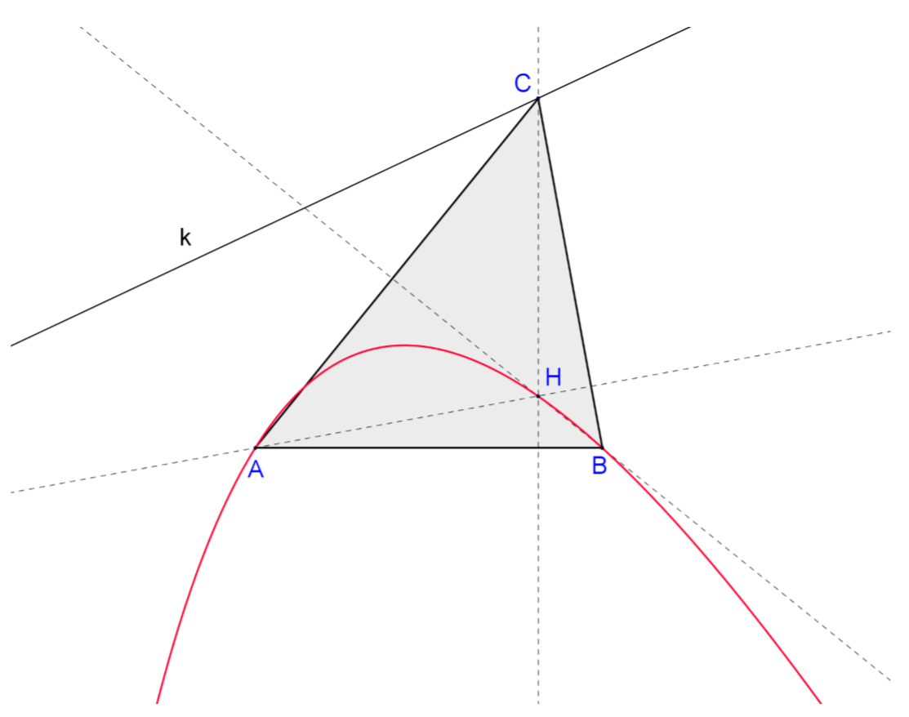
Problem - searching for loci
Let ABC be a triangle with a base AB and a vertex C on a given line k. Find the locus of the orthocentre H of ABC when C moves along the line k.

Slide 18
Problem – searching for loci
During searching for loci the students should keep the following rules:
First they demonstrate the problem with DGS and construct some points of the searched locus.
On the basis of the previous step they try to guess the locus.
Finally they use the window ”Locus” (Geogebra, Cabri,...) to draw the locus.

Slide 19
Problem - What is it?
Some students say: It is a parabola.
Other students say: It is a hyperbola.
Or it is neither parabola nor hyperbola?
What is the solution?
We’ll search for the locus equation

Slide 20
Searching for loci - General Approach III
Is it still not clear how the solution looks like?
CAS - The most powerful tool to solve geometrical problem in a plane or space
But for ordinary students it is very difficult to master all skills necessary to manage programs CAS
Present: command LocusEquation in 2D
Forthcoming future: merger of CAS and DGS software

Slide 21
Back to the Problem
Let ABC be a triangle with a base AB and a vertex C on a given line k. Find the locus of the orthocentre H of ABC when C moves along the line k.

Slide 22
Searching for loci - What is it?
The most accessible way for students is to use command „LocusEquation“
The problem is solved by CAS methods, providing tools to involve all possible cases
How to proceed in CAS ?

Slide 23
Searching for loci – procedure in CAS
First step: we choose coordinate system and equations of geometrical objects in such a way that problem is as simple as it is possible
For example: it is advantageous to identify some line with an axis of the coordinate system.
But we don’t want to restrict generality of a problem

Slide 24
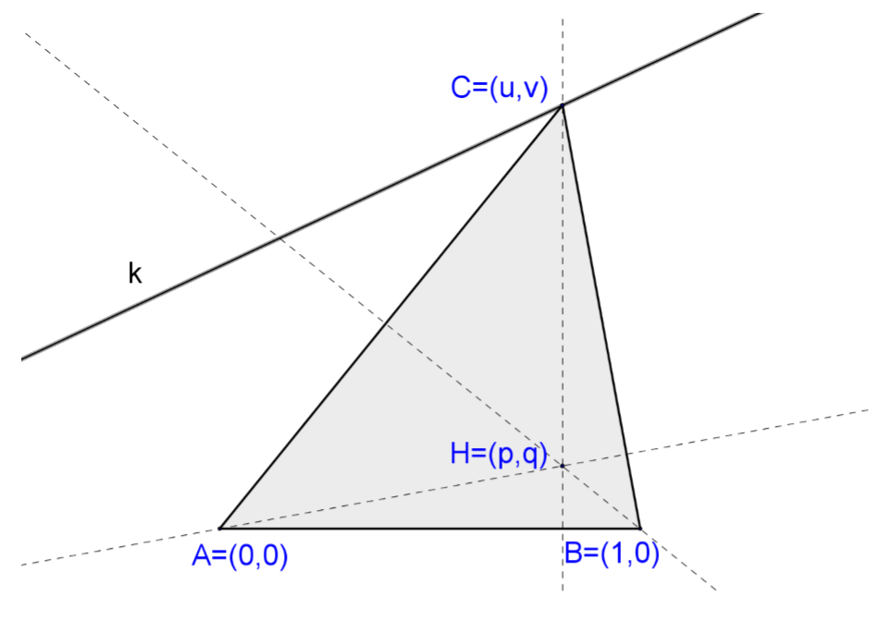
Searching for loci – procedure in CAS
Introduce a coordinate system such that A = (0,0), B = (1,0), C = (u,v), H = (p,q) and let k be an arbitrary line : ax + by + c = 0.

Slide 25
Searching for loci – procedure in CAS
Second step: Expressing assumptions of the problem in equations:
For the intersection H it holds:
(H −C) ⊥ (B −A) ⇔ h1 : (p−u,q−v)·(1,0) = 0,
(H −A) ⊥ (C −B) ⇔ h2 : (p,q)·(u−1,v) = 0.
Further
C ∈ k ⇔ h3 : au + bv + c = 0.
Notes:
Zbytečné detaily, do toho nikdo nebude pronikat, stejně budou všichni už spát.

Slide 26
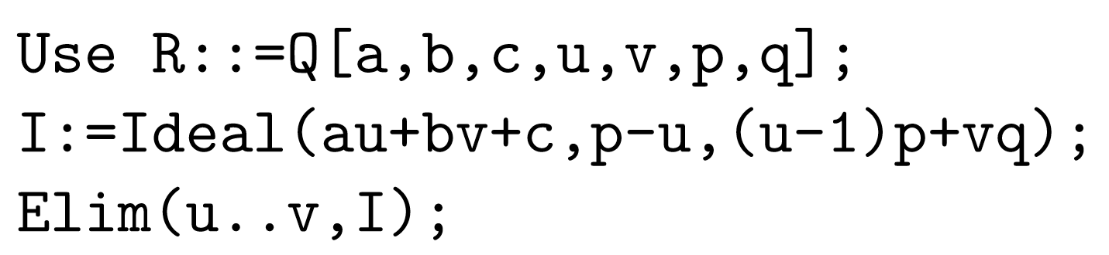
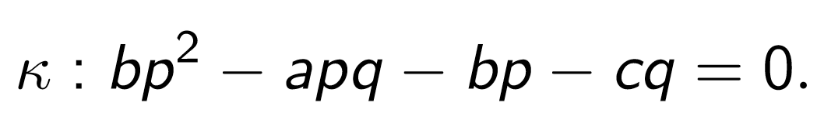
Searching for loci – procedure in CAS
Third step: elimination of variables
We get the system of three equations h1 = 0, h2 = 0, h3 = 0 in variables u, v, p, q, a, b, c.
To ﬁnd the locus of H = (p, q) we eliminate variables u, v in the ideal I = (h1,h2,h3) to obtain a relation in p, q which depends only on a, b, c. We enter
and get the equation :
Notes:
Vše toto silně zkrátit, doporučuji jenom napsat pár rovnic jako ilustraci, bez komentářů.

Slide 27
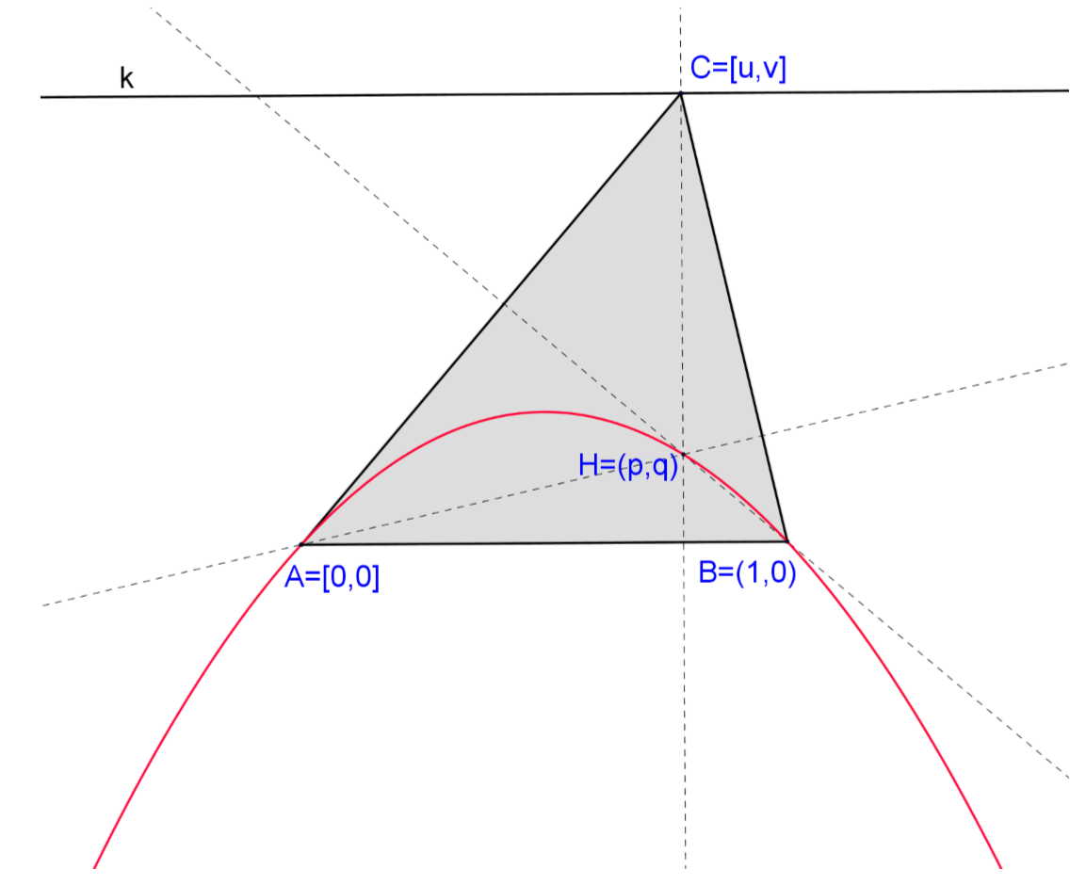

Searching for loci – procedure in CAS
If the locus is a parabola with the vertex and a parameter .

Slide 28
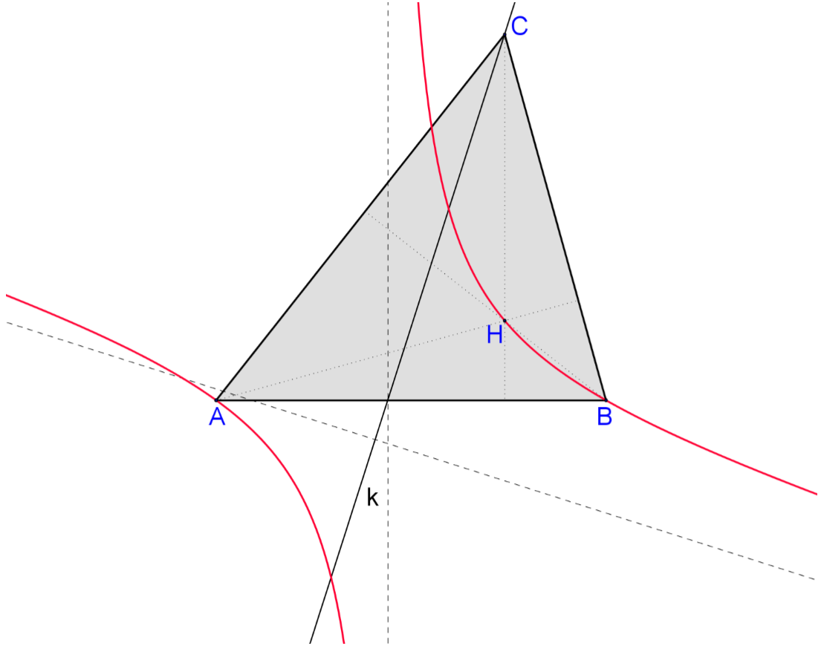

Searching for loci – procedure in CAS
If , we obtain a hyperbola centered at with one asymptote perpendicular to AB and the second asymptote perpendicular to the line k.

Slide 29
Searching for loci
The locus above was found by algebraic and computer tools.
It would be interesting to ﬁnd a classical geometric proof!
The next example shows how the knowledge of a solution, obtained by CAS, provides an important hint to finding classical solution

Slide 30
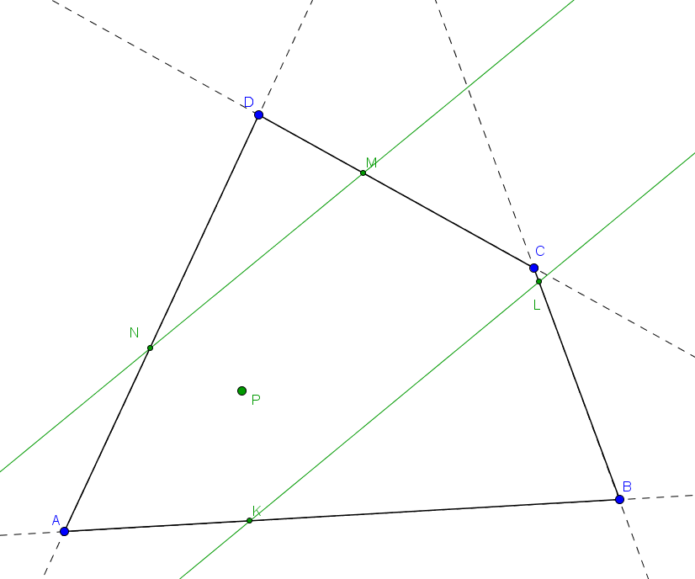
Problem II
Let´s have 4 mutually intersecting lines a, b, c, d in a plane. Our task is to find locus of points P with the following property: If we denote K, L, M, N the feet of perpendiculars from the point P to lines a, b, c, d respectively, then line KL is parallel to line MN.
Notes:
Výraznější obrázky, silnější čáry, větší písmo.

Slide 31
Problem II
What is the main distinction of the Problem II from the previous one?
We can not use command „locus“

Slide 32
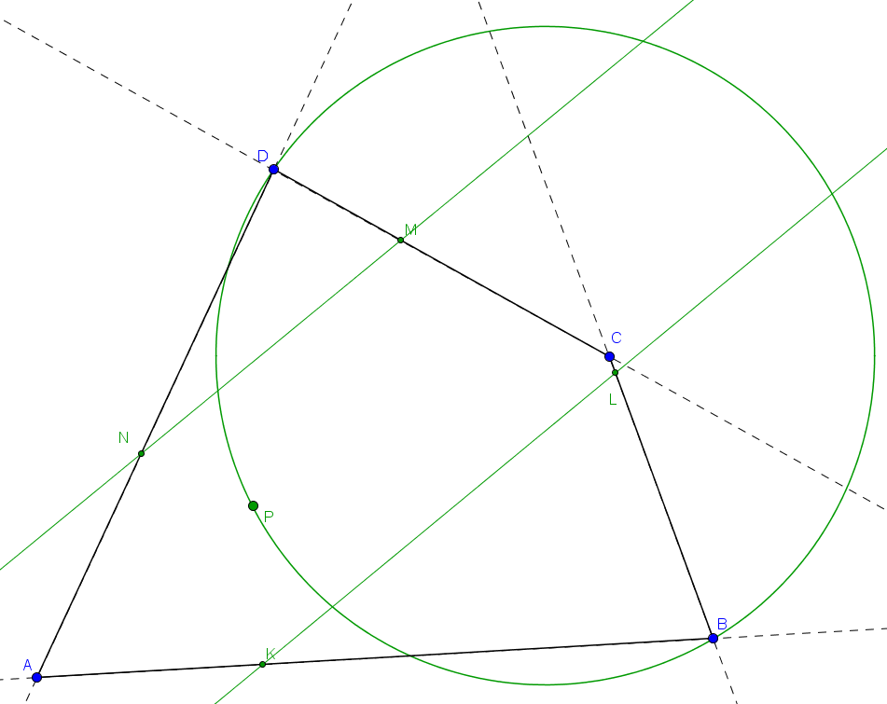
Problem II – simplest solution by GeoGebra
Drawback::
Is it a circle in all possible cases? Does every point of the circle satisfy our requirements ?

Slide 33
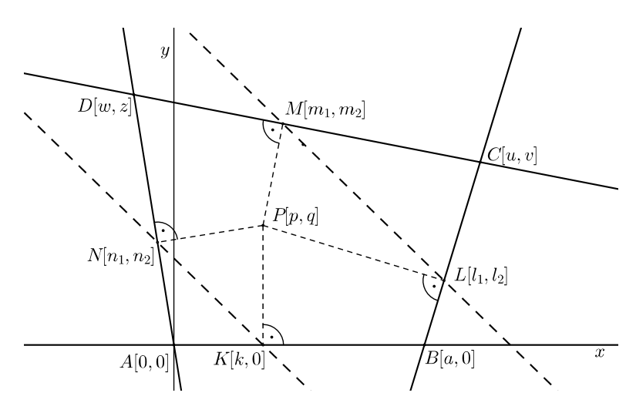
Solution by CAS
Notes:
Nechat jenom jako ilustraci, nekomentovat co je co.

Slide 34
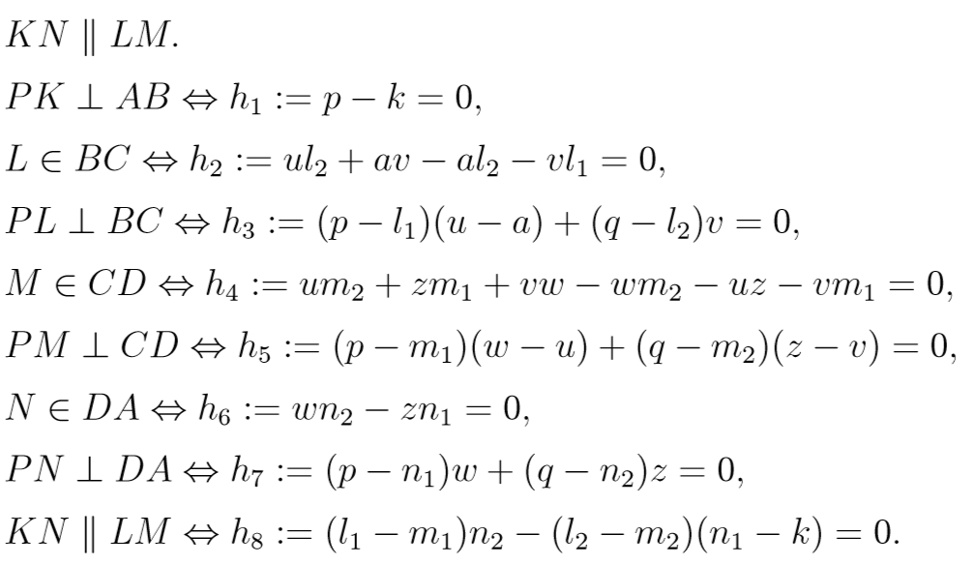
Expressing the Assumptions
Notes:
Totéž co k předchozímu slajdu.

Slide 35
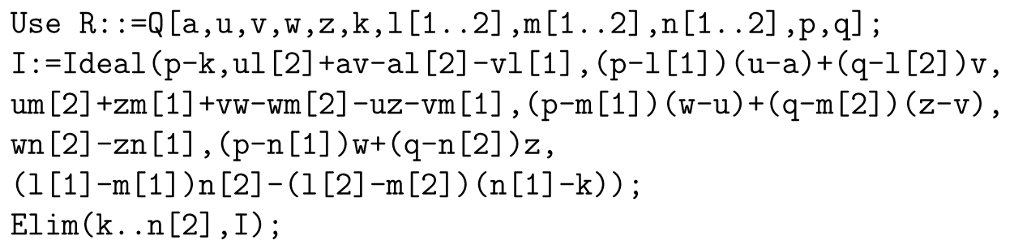
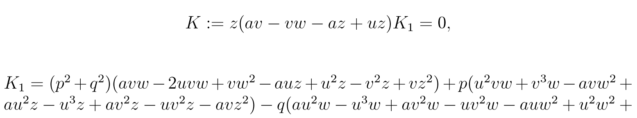
Solution by CAS
Previous assignment yields:
Notes:
Previous assignment yields:

Slide 36




Solution by CAS – non degeneracy conditions
Vertices A, B, D lie in a line
Vertices B, C, D lie in a line

Slide 37
Solution by CAS

Slide 38
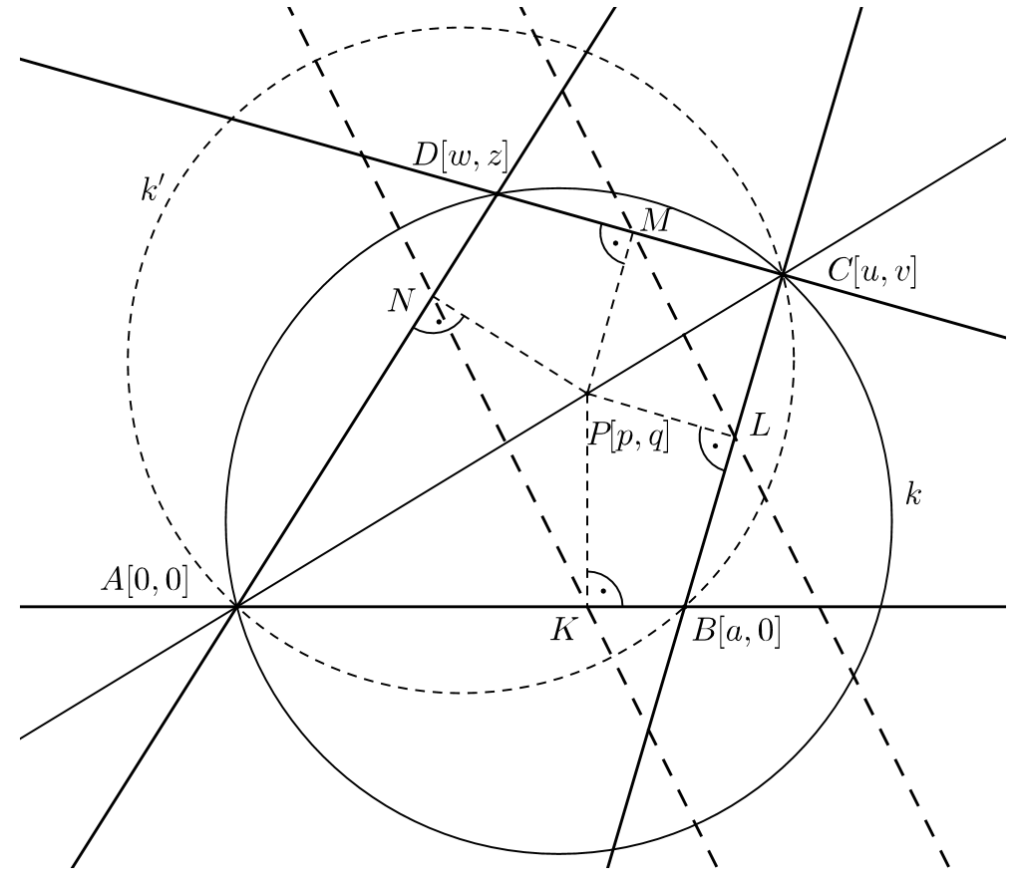

Slide 39

Solution by CAS - Converse implication
What we proved:
Assumptions
Conclusion
But does every point of „Conclusion“ really satisfy our „assumptions“?
Notes:
Nestejná velikost písma v rovnicích.

Slide 40
Solution by CAS - Converse implication
One must prove yet:
Conclusion
Assumptions

Slide 41
Solution by CAS - Converse implication
Normal Form – command NF
We have a set of equations, labelled Ideal (denote I)
Our question is: Does an equation h belong to I ?
Otherwise:
We use command NF. If the program responses NF = 0, then the equation h is a subset of I
If I then h is valid.

Slide 42
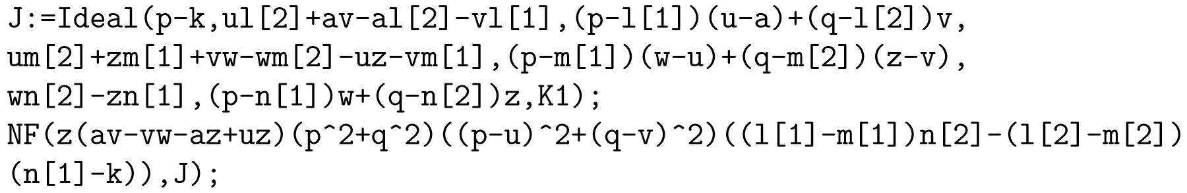





Solution by CAS - Converse implication

Slide 43
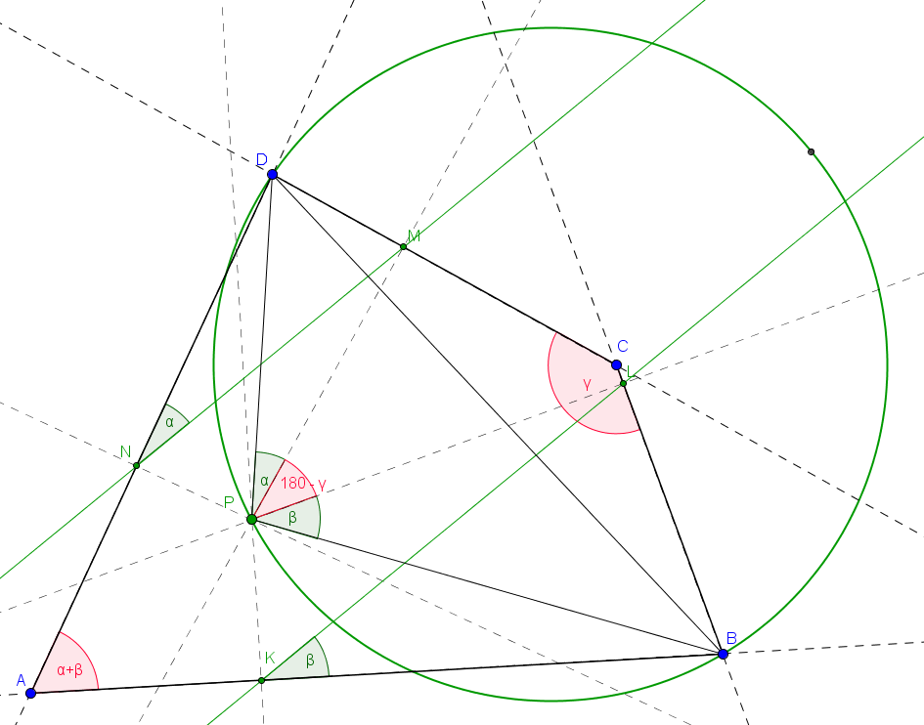
Problem II – Classical solution
What is crucial observation for classical proof ?
It is much easier to find solution if we know what we look for.

Slide 44
Problem III – space formulation of problem II
Let´s have 4 lines (a, b, c, d) in a space, all parallel to a given plane. Our task is to find a locus of points P, with the property that the feet K, L, M, N of perpendiculars from the point P to lines a, b, c, d, respectively, lie in a plane.

Slide 45
Problem III – dissection of the problem
Cases:
3 lines lie in a plane and the 4th is nonintersecting
2 lines lie in a plane and remaining 2 lines lie in another plane
General case - all lines are nonintersecting
(Classical solution is most valuable, but we can not rely that it will be always discovered)

Slide 46
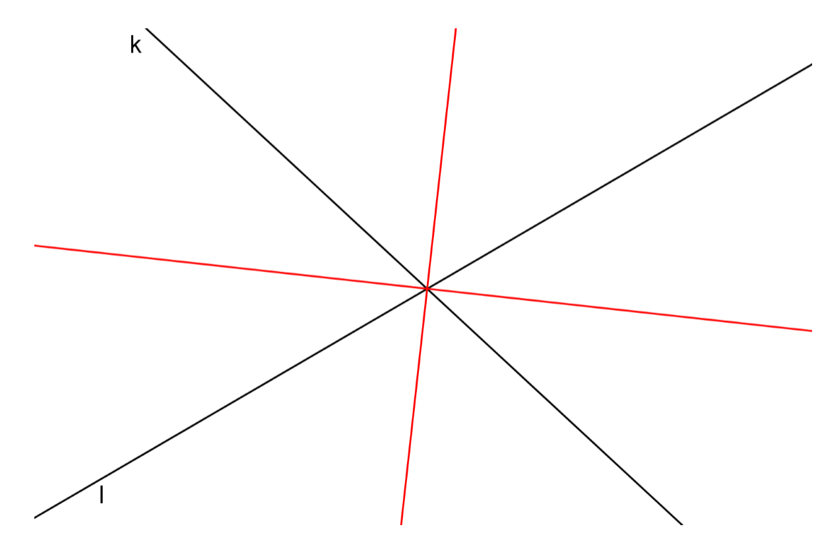
Problem IV - Searching for loci (3D example)
Two skew lines k, l are given. Determine the locus of points which have the same distance to the lines k and l.
If two lines k, l intersect, then the solution is well-known. The locus forms two mutually orthogonal lines (in a plane) or two mutually orthogonal planes (in a space) which bisect angles of the lines.

Slide 47
Searching for loci 3D
Obstacles:
We can not use tool „locus“ – It is caused by type of problem.
Programs DGS do not allowing verification of solution in 3D.
Command „LocusEquation“ does not work in 3D.
Merge of CAS and DGS in 3D is in the beginning.
We must rely only on CAS

Slide 48
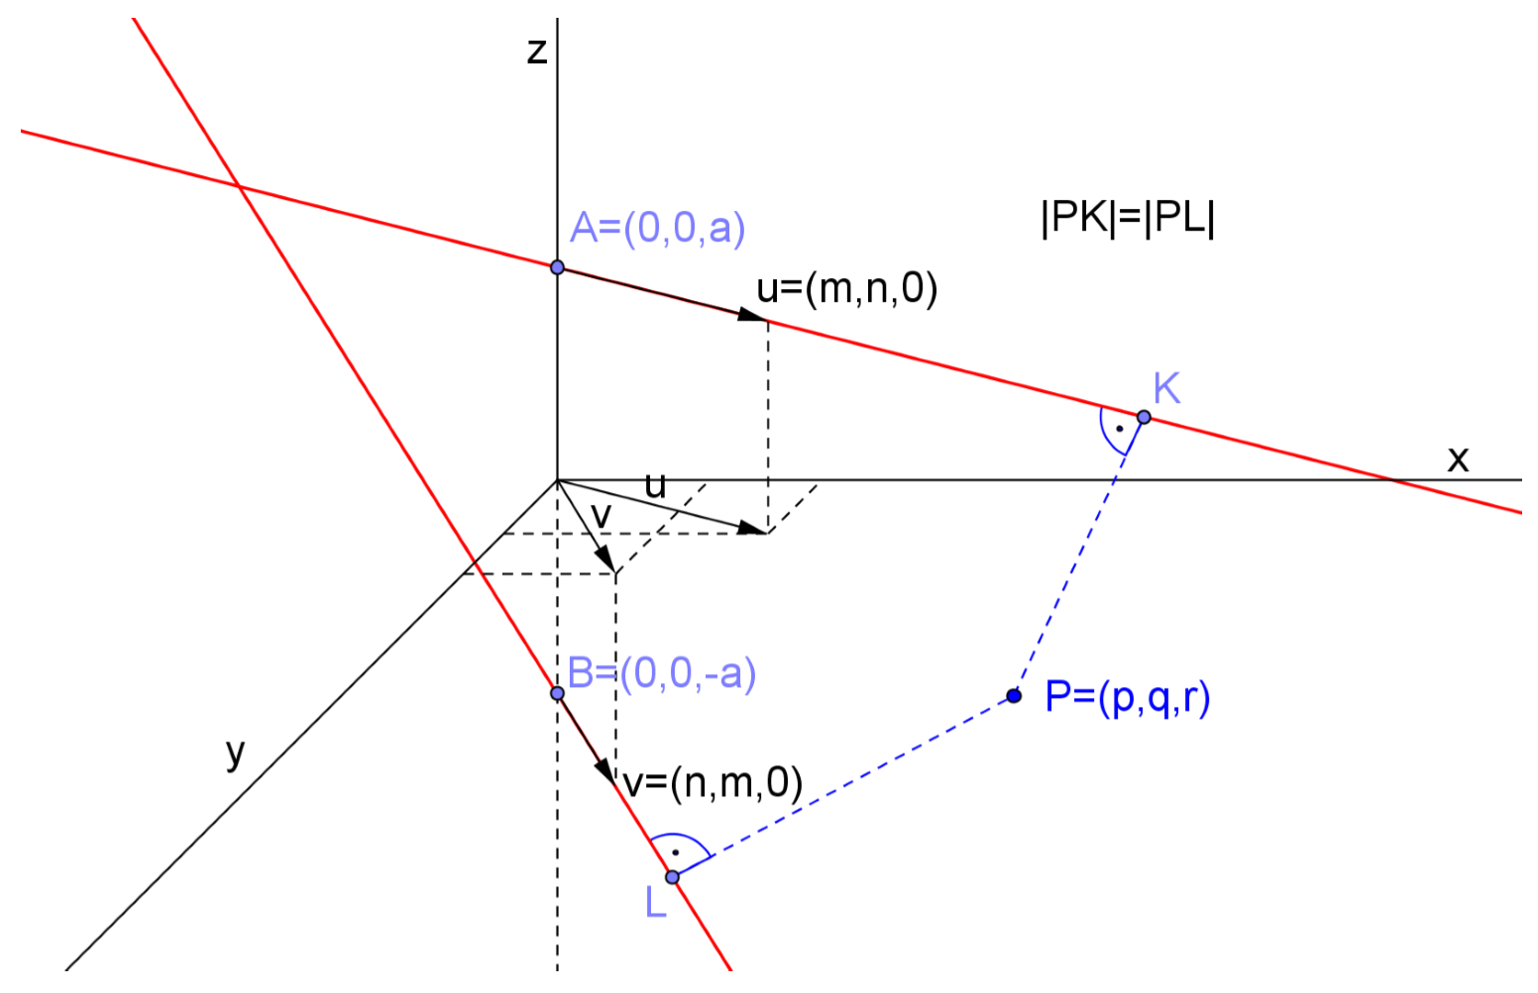
Searching for 3D loci
What is the locus if the lines k, l are skew?
We determine the locus equation.
Let k : and l : , where,

Slide 49
Searching for 3D loci

Slide 50
Searching for loci
Elimination of s, t, n in the system gives
We see that this is the equation of an equilateral hyperbolic paraboloid

Slide 51
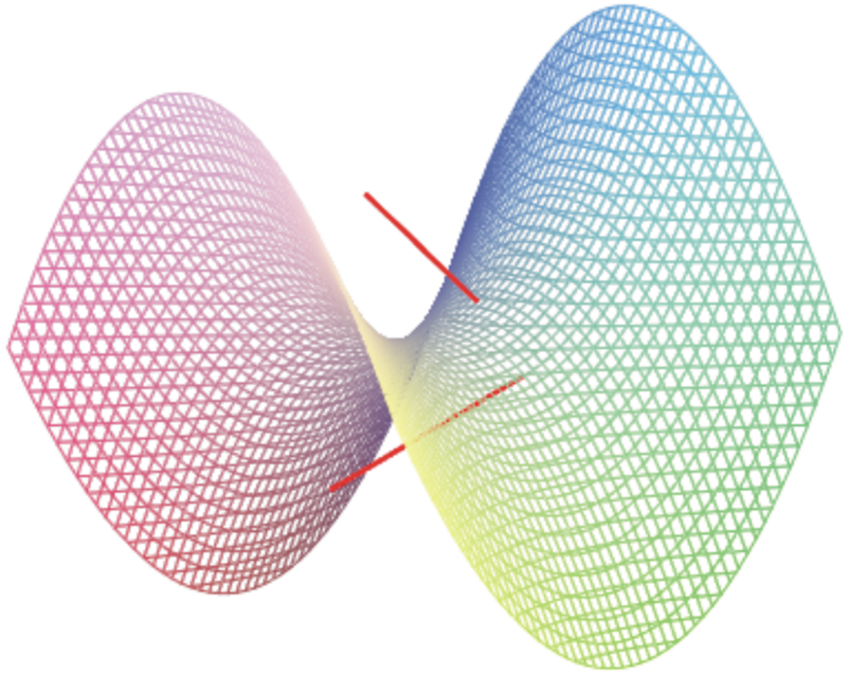
Searching for loci
For m = 1/2 and a = 1 we get a hyperbolic paraboloid .

Slide 52
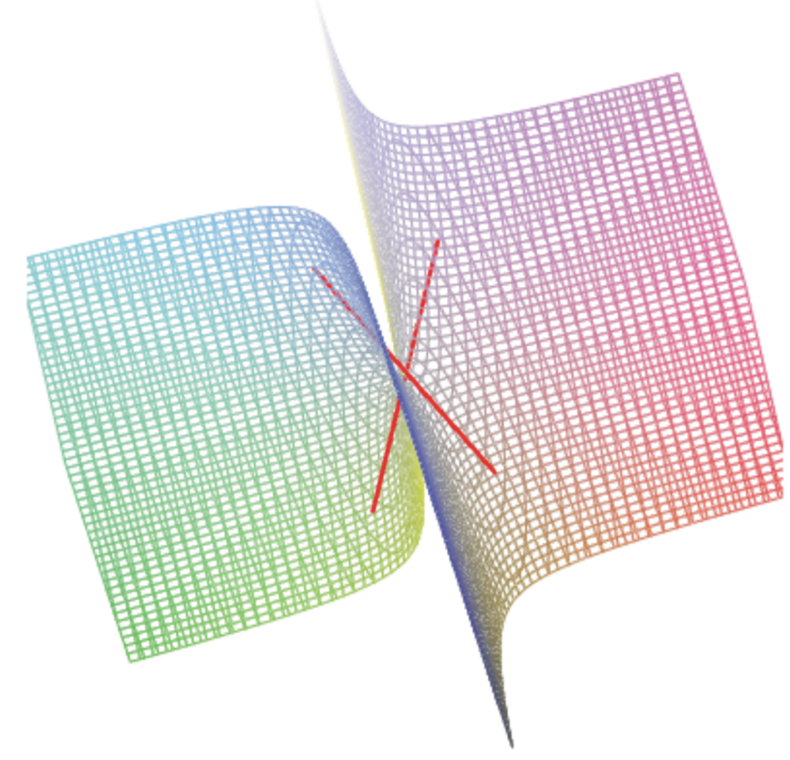
Searching for loci
Note that the less is the coeﬃcient a (i.e. the skew lines are at the smaller distance) the more is the hyperbolic paraboloid similar to two orthogonal planes.

Slide 53
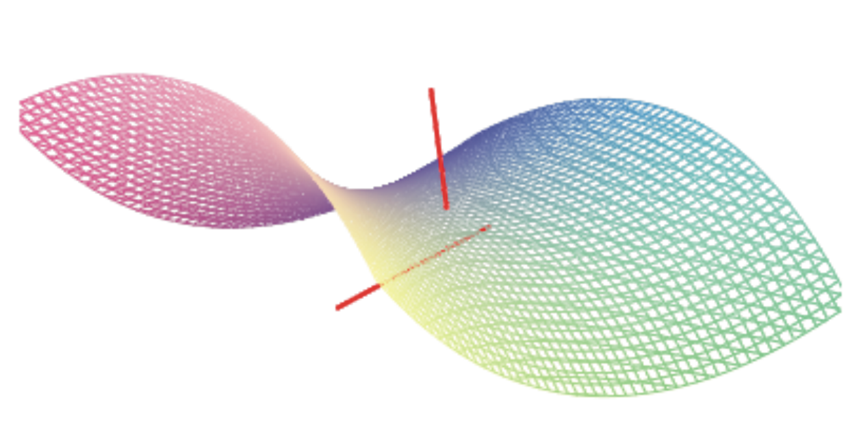
Searching for loci
If m and n tend to have equal directions (i.e. the skew lines tend to be parallel) then the hyperbolic paraboloid is similar to a plane.

Slide 54
Veriﬁcation in 3D
If the locus is in 3D then veriﬁcation is more complicated.
Locus in a plane can be (numerically) veriﬁed either by ruler and compasses of by DGS.
We can verify the last locus by the method of descriptive geometry with the use of DGS.

Slide 55
Summarize
1. step: Can we use command „locus“?
2. step: Can we guess after the 1st step what is the solution of the problem?
3. step: Are we able to find solution by CAS software?
4. step: Did we find a classical solution?
5. step: Is it possible to find classical solution without any help of analytic geometry?
 | Problem 1 | Problem 2 | Problem 3 | Problem 4
1. step | Yes | No | No | No
2. step | Yes | No | No | No
3. step | Yes | Yes | Yes | Yes
4. step | No | Yes | Only partly | No
5. step | Prob. Yes | Yes | Prob. Yes | Prob. No

Slide 56
Thank you for your attention

Slide 57
Problem II – Classical solution

